Slide 1
Predicting Parkinson's Using Drawings
By Joshua Wilson

Slide 2
Overview
Parkinson's is a neurological disease that affects 500,000 people in the U.S alone and it is often considered by many experts in the field to be greatly underdiagnosed
The primary diagnosing tool is the spiral drawing test

Slide 3
Problem
One of the many issues that causes this large underdiagnosis is for a couple of factors
Not enough experts
Time consuming
Cost
Misdiagnosis of symptoms

Slide 4
Proposal
This project aims to help alleviate some of the issues around the underdiagnosis of Parkinson's patients, specifically related towards: cost, time, and expertise. The way this project will work is by:
Using a series of Machine learning applications
Using novel features that haven’t been combined in this way

Slide 5
Proposal
In this project I will use a novel feature called Lift
Lift = Σ(P_i) = 0, for i = 1 to n
The goal of this project is to determine this new variables effectiveness at helping predict the chances of Parkinsons and how does it compare to the current literature

Slide 6
Research Questions
How can adding a new novel feature help with classifying Parkinson's?
How does this new feature compare to other features?

Slide 7
Lit Review 1
Literature Review: Distinguishing Different Stages of Parkinson’s Disease Using Composite Index of Speed and Pen-Pressure of Sketching a Spiral
Handwriting and drawing tasks are used to assess Parkinson's disease due to it affecting fine motor skills.
Speed and pen-pressure in spiral sketching are negatively correlated with Parkinson severity.
Pen lift may influence speed and pen-pressure: a. Higher frequency of pen lifts: slower speed, reduced pen-pressure b. Fewer pen lifts: faster speed, more consistent pen-pressure
Zham P, Kumar DK, Dabnichki P, Poosapadi Arjunan S and Raghav S (2017) Distinguishing Different Stages of Parkinson’s Disease Using Composite Index of Speed and Pen-Pressure of Sketching a Spiral. Front. Neurol. 8:435. doi: 10.3389/fneur.2017.00435

Slide 8
Lit Review 2
Digitized spiral drawing classification for Parkinson's disease diagnosis
Objective:
Classify spiral drawing images of healthy controls and Parkinson patients
Assist medical practitioners in early Parkinson diagnosis
Machine Learning Models:
Logistic Regression
Random Forest Classifier
Support Vector Classifier (SVC)
KNeighborsClassifier
Results:
91.6% accuracy, 98.1% AUC using Logistic Regression
Kamble, M., Shrivastava, P., & Jain, M. (2021). Digitized spiral drawing classification for parkinson's disease diagnosis. Measurement: Sensors, 16, 100047. https://doi.org/10.1016/j.measen.2021.100047

Slide 9
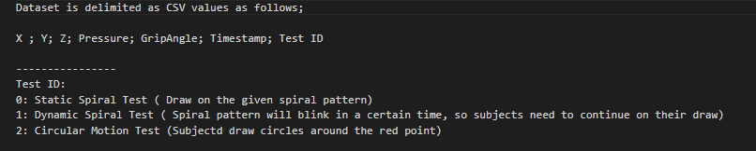
Data and Dataset
The main dataset used in this project is the UCI Machine Learning dataset on Parkinson's Spiral drawings. This data set contains 62 Parkinson sample and 15 healthy samples

Slide 10
EDA

Slide 11
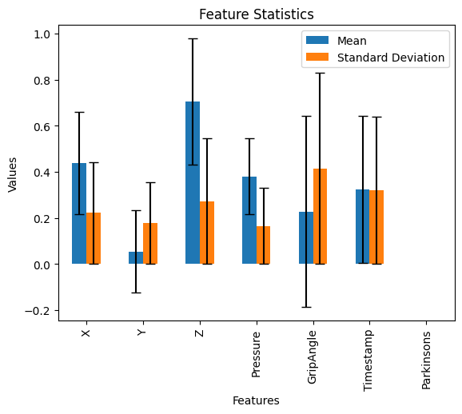
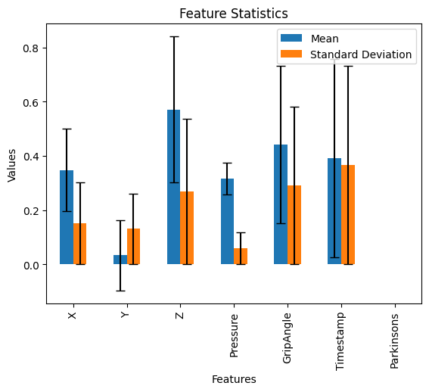
Comparison of Default Values Scaled
Control Parkinson

Slide 12
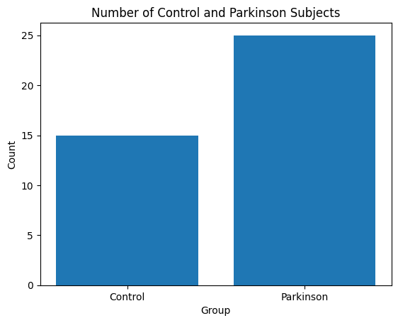
Comparison of Group Sizes
25 Parkinson
15 Healthy

Slide 13
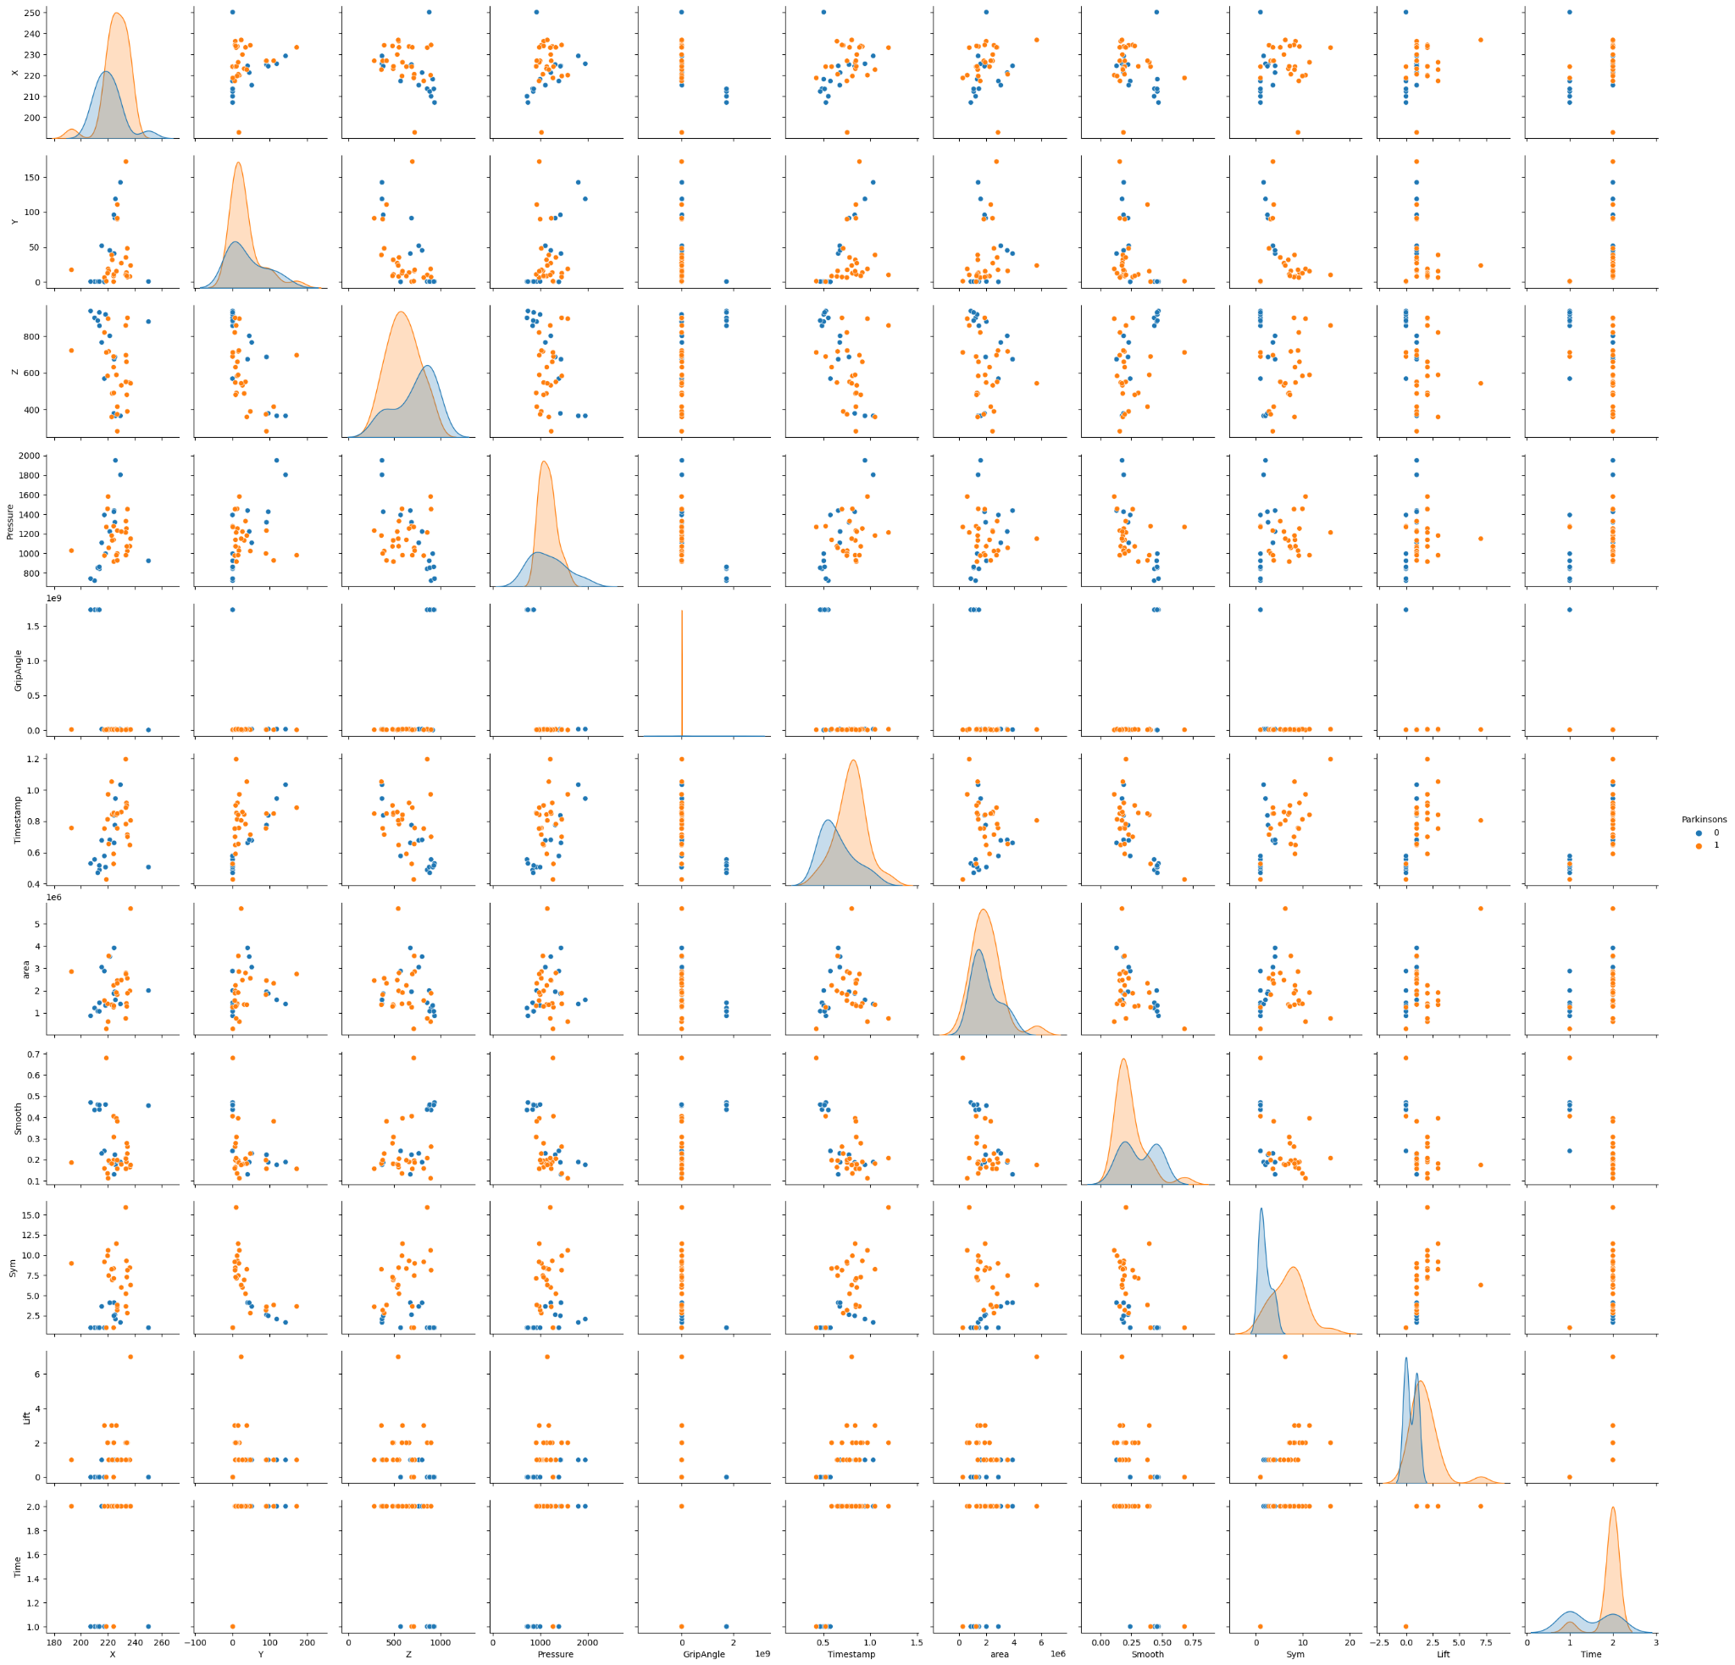

Slide 14
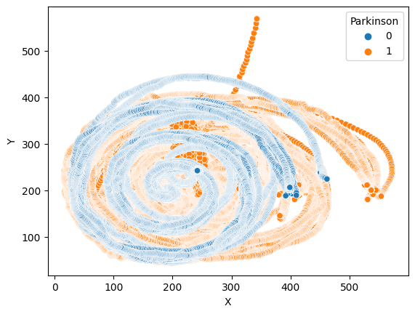
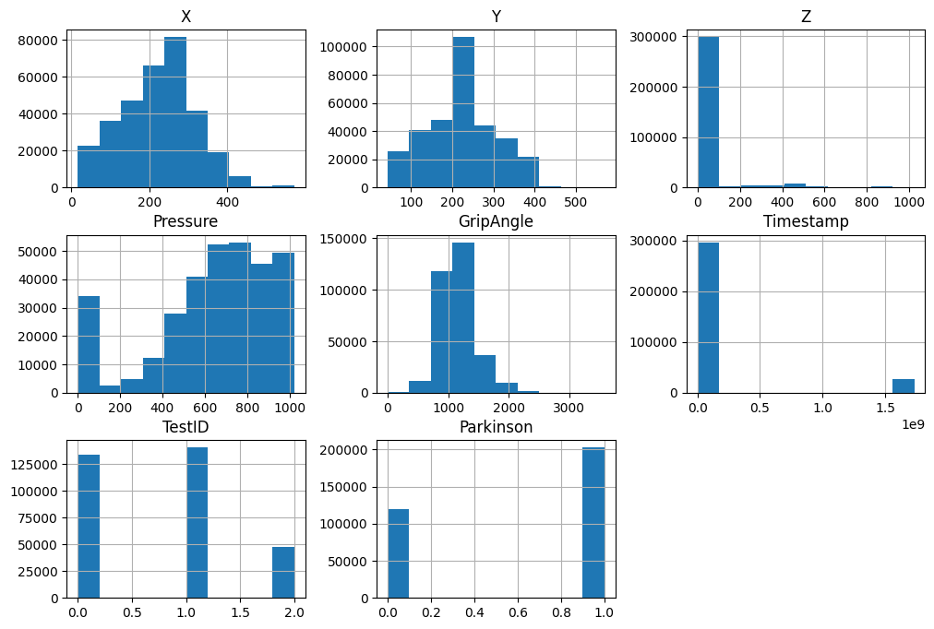
Scatter Plot and Histogram of Combined Groups

Slide 15
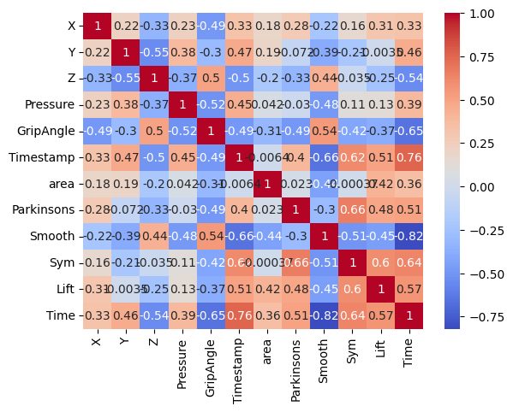
Correlation
Important Factors:
1. Symmetry : .66
2. Time : .51
3. Grip Angle : -.49
4. Lift: .48

Slide 16
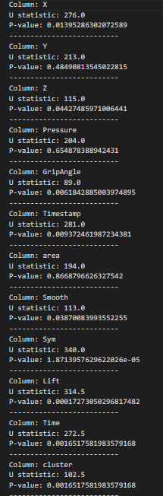
Feature Selection
Using a Mann-Whitney U test these were the variables found to have a
Statistically significant relationship to Parkinson's
X
Z
GripAngle
Smooth
Sym
Lift
Time

Slide 17
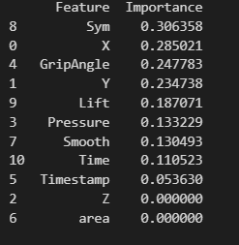
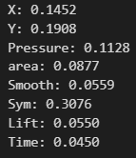
Variable Selection
Random Forest Selection ANOVA Best Feature Importance Mutual info

Slide 18
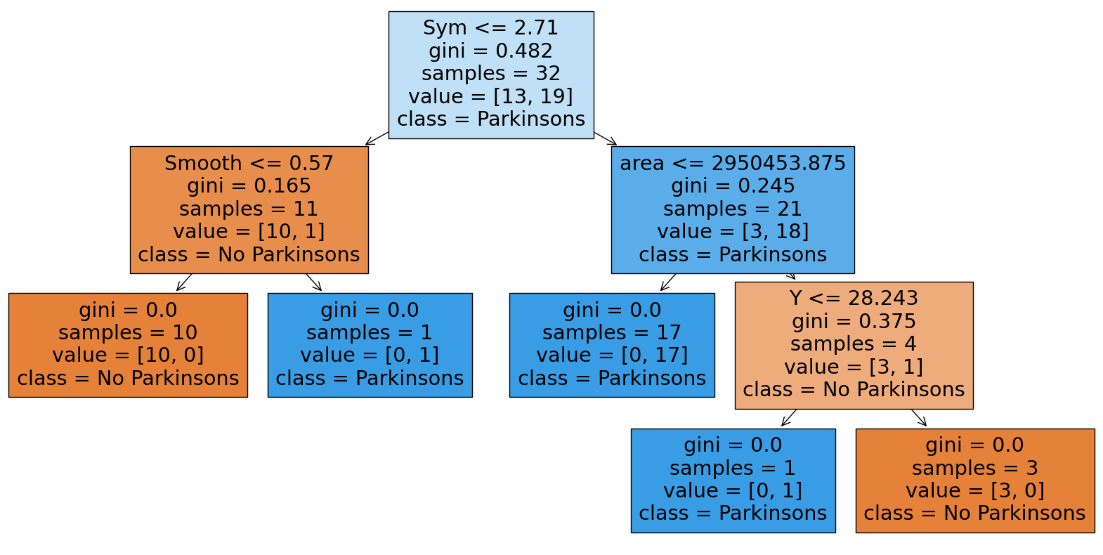

Slide 19
Clustering
Clustering was used to help preprocess and added a layer to separate the data
The data was scaled to help improve the accuracy as a new feature

Slide 20
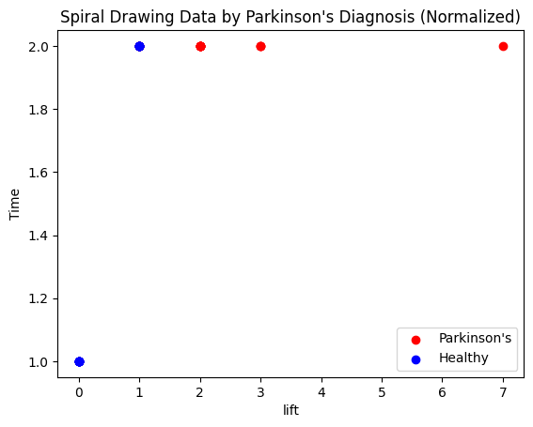
Clustering With Time and Lift
Silhouette Score: 0.8004513217118662

Slide 21
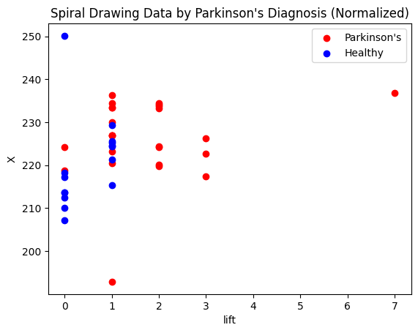
Clustering With X and Lift
Silhouette Score: 0.42033698846995177

Slide 22
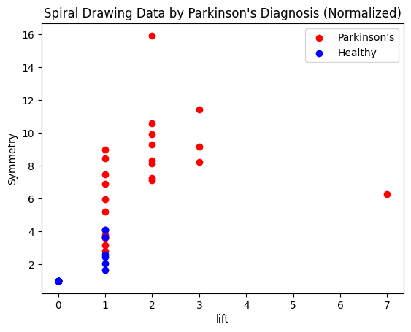
Clustering With Symmetry and Lift
Silhouette Score: 0.5770040296864859

Slide 23
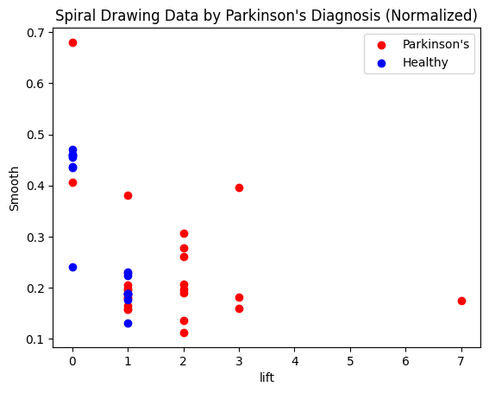
Clustering With Smooth Lift
Silhouette Score: 0.6195390589336549

Slide 24
Model Selection

Slide 25
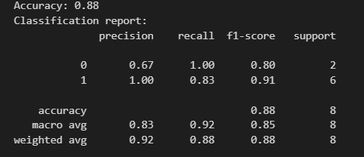
Random Forest

Slide 26
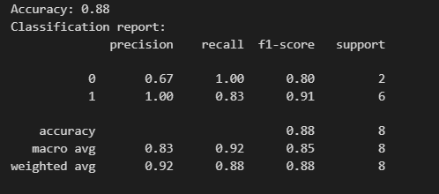
With Clustering

Slide 27
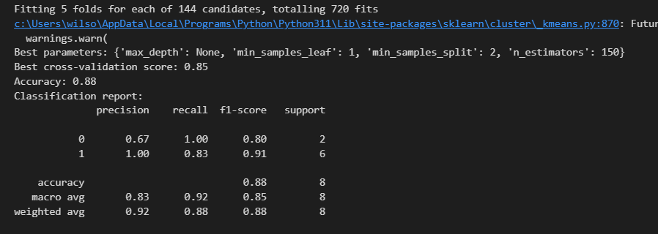
With K Fold and GridSearch

Slide 28
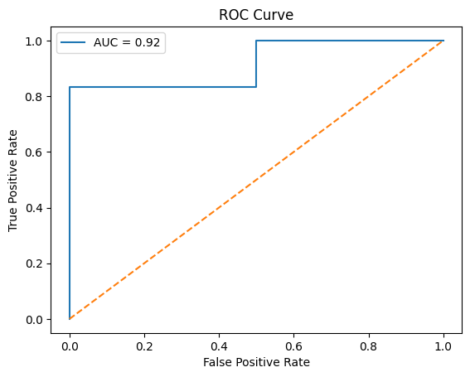
AUC ROC Curve

Slide 29
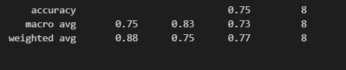
SVM

Slide 30
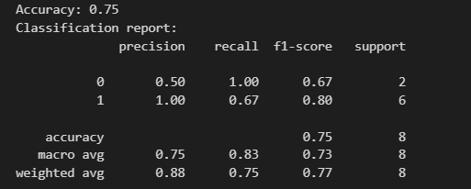
With Clustering

Slide 31
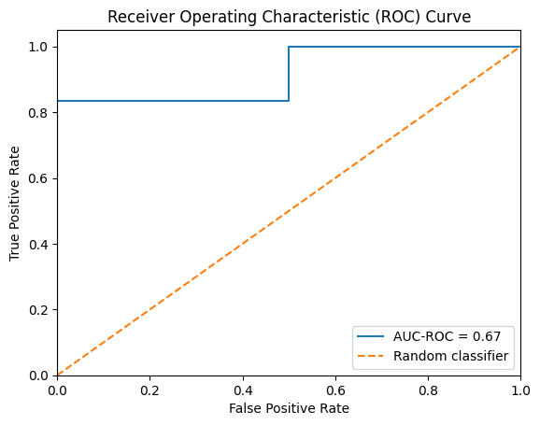
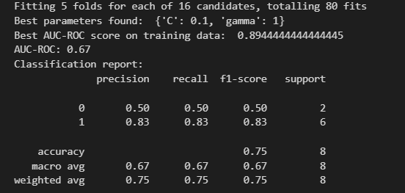
SVM Tuned

Slide 32

Neural Network Un Tunned

Slide 33
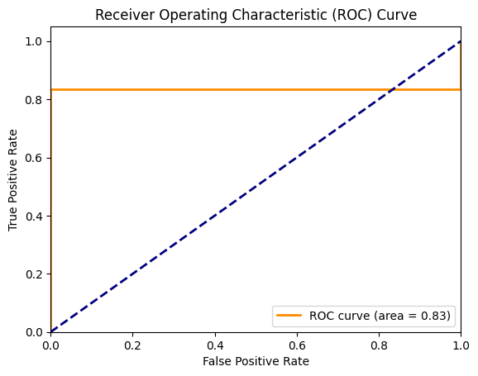
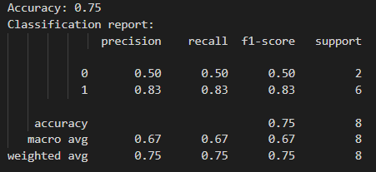
With Clustering

Slide 34
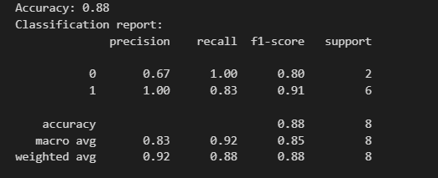
GBM

Slide 35
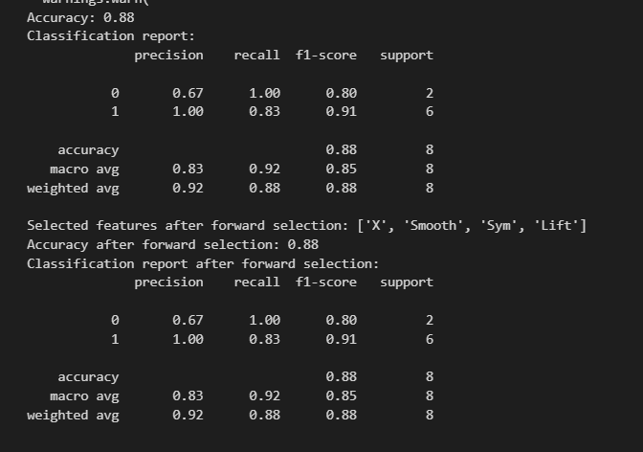
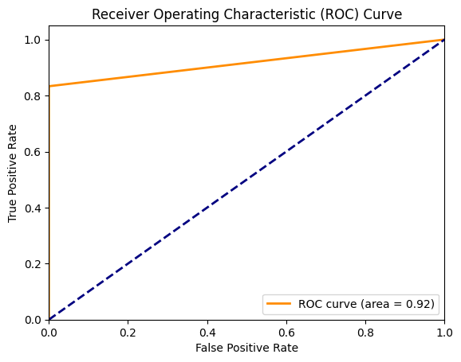
GBM With Clustering and Selection

Slide 36
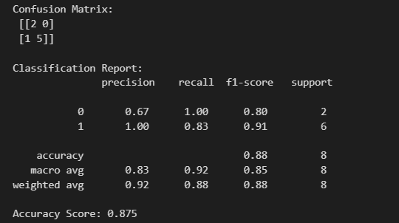
Logistic Regression

Slide 37
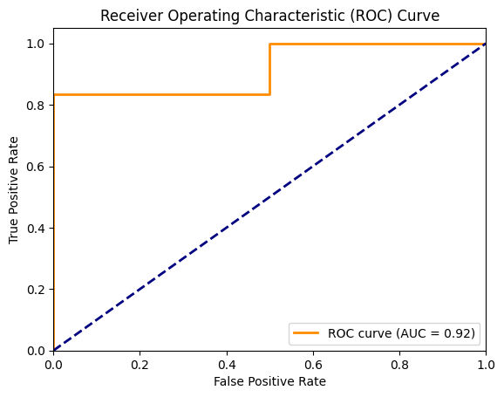
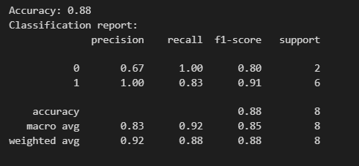
XGboost

Slide 38
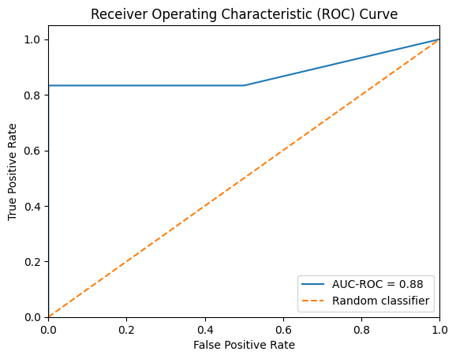
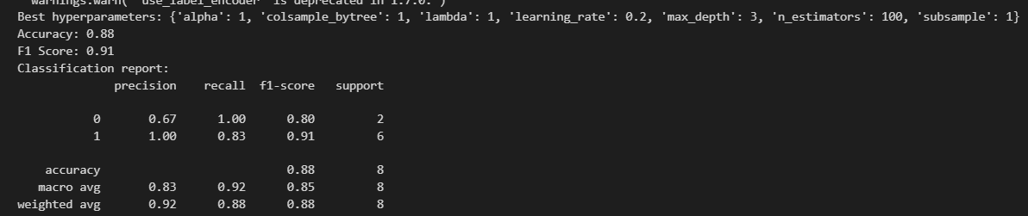
With Clustering and Grid Search

Slide 39
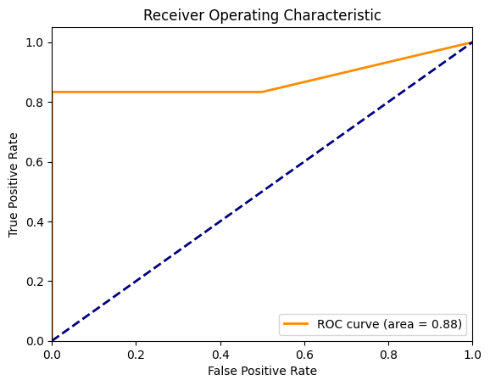
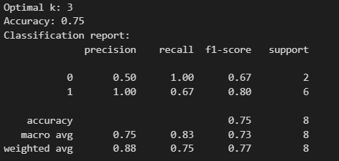
K Nearest

Slide 40
Gradient Boosting Machine (GBM):
Reduces bias and variance
Improved model performance
High F1, Precision, Accuracy, AUC
Logistic Regression:
Simple and interpretable
Baseline model
Moderate performance
XGBoost:
Fast and efficient
Handles large datasets
High F1, Precision, Accuracy, AUC
K-Nearest Neighbors (KNN):
Simple and intuitive
Handles non-linear relationships
High F1, Accuracy, AUC, lower Precision
Random Forest:
Flexible and robust
Handles feature interactions
High F1, Precision, Accuracy, AUC
Support Vector Machine (SVM):
Effective in high-dimensional spaces
Clear margin of separation
Moderate performance
Neural Network:
Highly flexible
Captures complex patterns
High Precision, lower F1, Accuracy, AUC

Slide 41
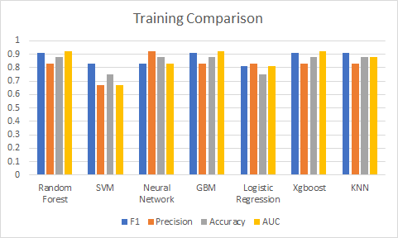
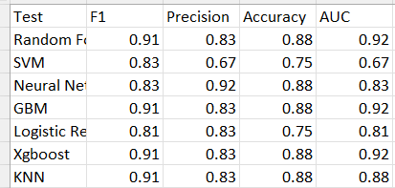

Slide 42
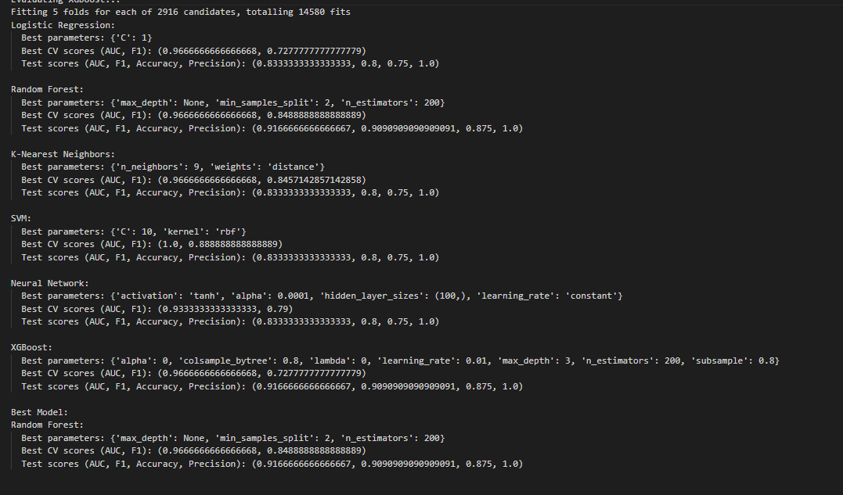
Comparing Overall Models

Slide 43
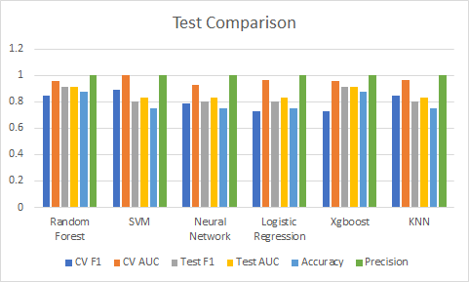
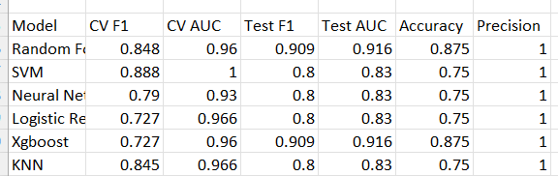
Results

Slide 44
Tuning
Random Forest:
n_estimators: Number of trees in the forest.
max_depth: Maximum depth of the tree.
SVM:
C: Regularization parameter, also known as the cost parameter, which determines the trade-off between achieving a low training error and a low testing error.
kernel: Specifies the kernel type to be used in the algorithm ('linear', 'poly', 'rbf', 'sigmoid').
Neural Network:
hidden_layer_sizes: The number of neurons in the hidden layers.
activation: Activation function for the hidden layers ('logistic', 'tanh', 'relu').

Slide 45
Tuning
Logistic Regression:
C: Inverse of regularization strength; smaller values specify stronger regularization.
penalty: Used to specify the norm used in the penalization ('l1', 'l2', 'elasticnet', 'none').
XGBoost:
n_estimators: Number of boosting rounds to be run.
learning_rate: Boosting learning rate, or the shrinkage factor.
max_depth: Maximum depth of a tree.
KNN:
n_neighbors: Number of neighbors to use for the k-nearest neighbors algorithm.
weights: Weight function used in prediction ('uniform', 'distance').

Slide 46
Model | Best Parameters
Logistic Regression | {'C': 1}
Random Forest | {'max_depth': None, 'min_samples_split': 2, 'n_estimators': 200}
K-Nearest Neighbors | {'n_neighbors': 9, 'weights': 'distance'}
SVM | {'C': 10, 'kernel': 'rbf'}
Neural Network | {'activation': 'tanh', 'alpha': 0.0001, 'hidden_layer_sizes': (100,), 'learning_rate': 'constant'}
XGBoost | {'alpha': 0, 'colsample_bytree': 0.8, 'lambda': 0, 'learning_rate': 0.01, 'max_depth': 3, 'n_estimators': 200, 'subsample': 0.8}

Slide 47

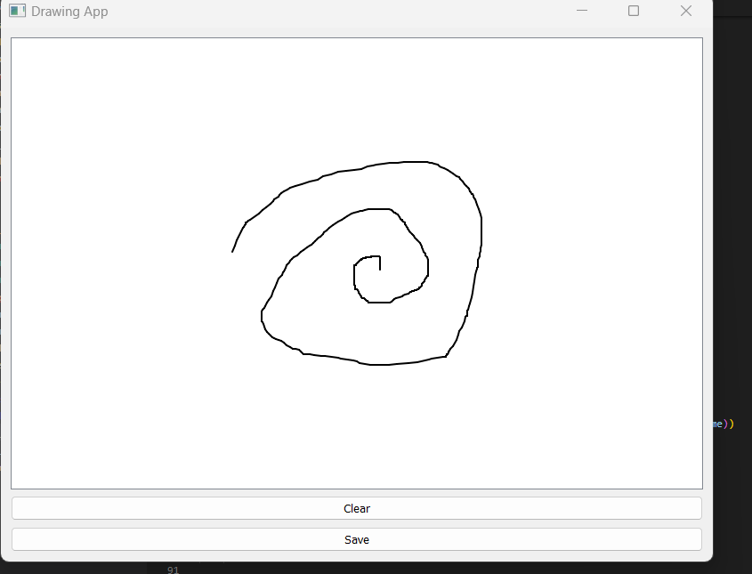
Application

Slide 48
Summary
Compared to current literature 91.6% accuracy, 98.1% AUC using Logistic Regression the best score I was able to achieve was 87.5 % accuracy, and 91.6% AUC on tests for random forest which is similar to current literature for Random forest in this scenario.
While not passing the current best score this does give a new feature that has been shown to help accurately predict Parkinson's
New feature 'Lift' shows promising results
Correlation with Parkinson's: 0.48
Mann-Whitney U test p-value: 0.00017
Statistically significant relationship with Parkinson's
Best score with Lift included:
Random Forest: 87.5% accuracy, 91.6% AUC
XGBoost: 87.5% accuracy, 91.6% AUC
Performance comparable to current literature for Random Forest
Lift's benefits:
Provides additional insight for early detection of Parkinson's disease
Enhances the performance of machine learning models
Adds to the existing set of significant features for researchers to use

Slide 49
References
Zham P, Kumar DK, Dabnichki P, Poosapadi Arjunan S and Raghav S (2017) Distinguishing Different Stages of Parkinson’s Disease Using Composite Index of Speed and Pen-Pressure of Sketching a Spiral. Front. Neurol. 8:435. doi: 10.3389/fneur.2017.00435
Kamble, M., Shrivastava, P., & Jain, M. (2021). Digitized spiral drawing classification for parkinson's disease diagnosis. Measurement: Sensors, 16, 100047. https://doi.org/10.1016/j.measen.2021.100047
Isenkul, M.E.; Sakar, B.E.; Kursun, O. . 'Improved spiral test using digitized graphics tablet for monitoring Parkinson's disease.' The 2nd International Conference on e-Health and Telemedicine (ICEHTM-2014), pp. 171-175, 2014.
2.Erdogdu Sakar, B., Isenkul, M., Sakar, C.O., Sertbas, A., Gurgen, F., Delil, S., Apaydin, H., Kursun, O., 'Collection and Analysis of a Parkinson Speech Dataset with Multiple Types of Sound Recordings', IEEE Journal of Biomedical and Health Informatics, vol. 17(4), pp. 828-834, 2013.

